Slide 1


Probing Dark Dwarf Galaxies with Gravitational Lensing
Kaiki Taro Inoue (KINDAI U.)
Seminar@Osaka U 22 Feb 2017

Slide 2
Outline
Missing Satellite Problem
Gravitational Lensing
Substructure vs Line-of-sight Halos
ALMA Observations (SDP.81, MG0414+0534)
Summary and Future Prospects

Slide 3
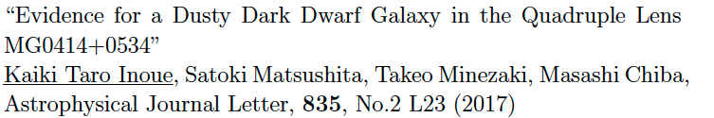
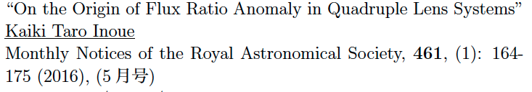
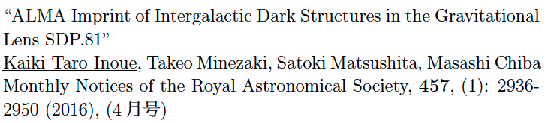
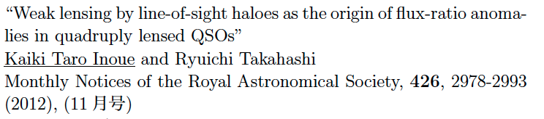
References

Slide 4
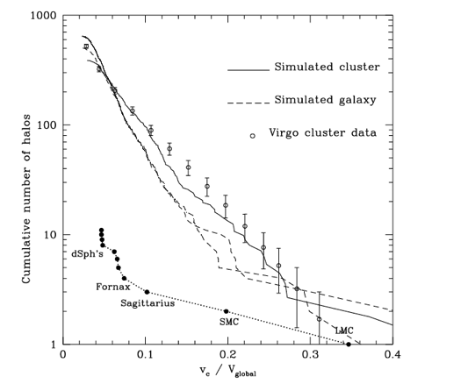
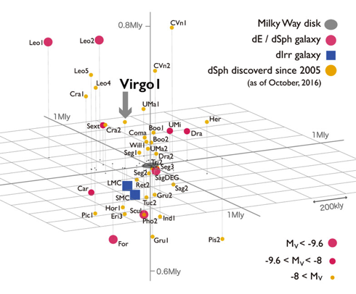
Missing Satellite Problem
Milky Way （Homma et al.)
Simulation (Moore et al.)
Observation:N~40
Theory:N>500

Slide 5
Possible Solutions
Large scatter
Baryon physics
Dark matter physics
How many dark subhalos in a MW-sized galaxy?

Slide 6
Detection Methods
Faint signals
Gravitational lens
DM self-annihilation
Gravitational wave

Slide 7
Gravitational lens
α
source plane
lens plane
: gravitational acceleration

Slide 8
Gravitational lens
α
source plane
lens plane
: convergence

Slide 9
Parity in circular lens
(+ +)
(- +)
source plane
lens plane

Slide 10
Parity in elliptical lens
(- +)
(+ +)
(+ +)
(- +)
source plane
lens plane

Slide 11
Parity & magnification change
always magnified
(+ +) parity
demagnified or magnified
(+ −) parity

Slide 12
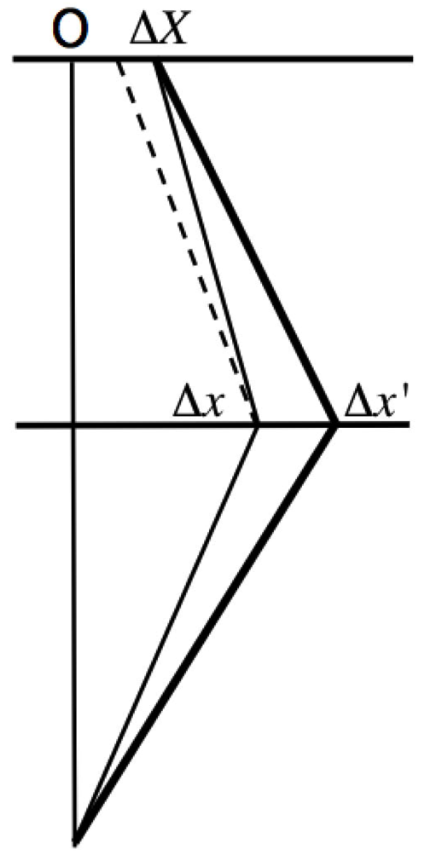
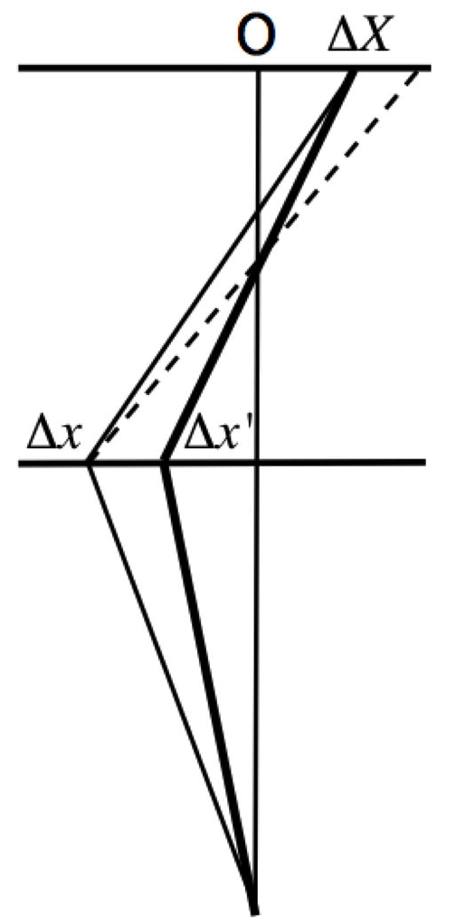
+parity
−parity

Slide 13
Flux-ratio anomaly
Assume a smooth potential
Positions well fit (<0.01)
Flux ratios not well fit (~0.1)
Evidence for subhalos?
(Mao & Schneider ’ 98 Metcalf & Madau’01,
Chiba ’02, Dalal & Kochanek’02 ond many others)

Slide 14
Position and flux
Position from OPT/NIR data
Flux from MIR/radio data
OPT/NIR suffers from dust extinction
and mirolensing by stars

Slide 15
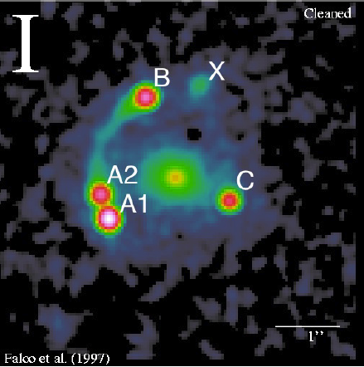
MG0414+0534 (NIR)
(0.4)
(1.0)

Slide 16
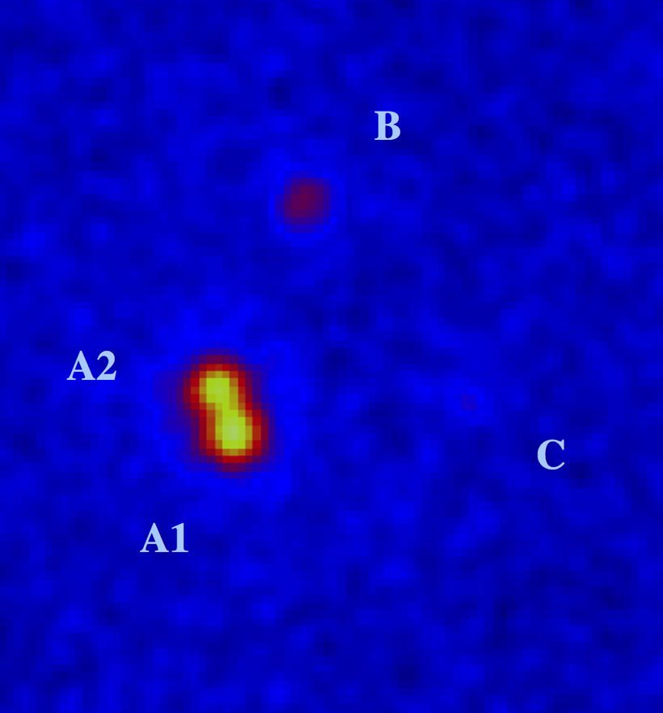
MG0414+0534 (MIR)
(0.9)
(1.0)

Slide 17
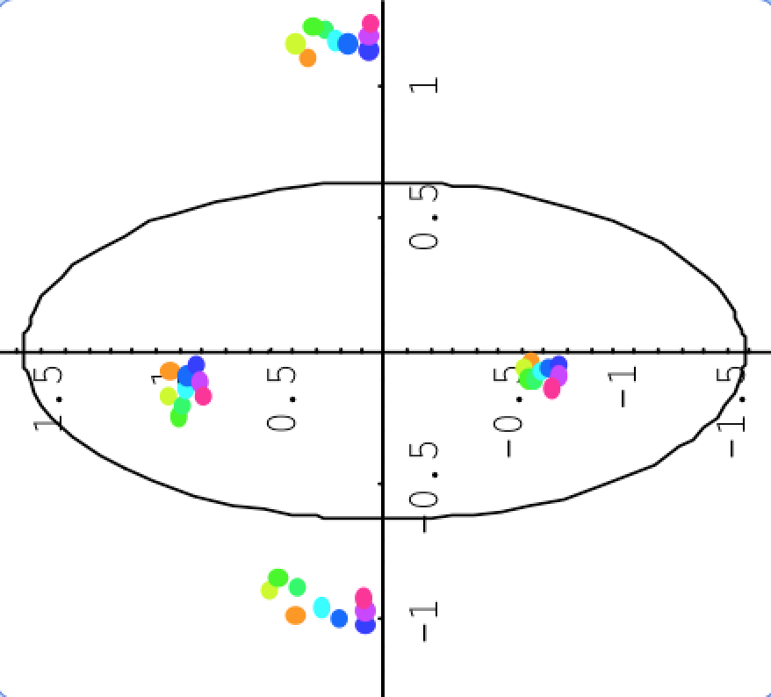
MG0414+0534 (MIR)
0.9
1.0

Slide 18
What is the origin of the flux-ratio anomalies?

Slide 19
Possible origins
Subhalos in lens
Complex structures in lens
Line-of-sight structures

Slide 20
subhalo
quasar
galaxy
void
halo

Slide 21
Previous studies on LOS
LOS halos contribute <10% (Chen et al. ’03)
LOS halos are “enough” for
cusp-caustic lenses (Metcalf ’05, ’07
Miranda & Maccio ’07)
LOS halos contribute 10~20% (Xu et al. ’12)
Fluctuations not considered!

Slide 22
What is New?
η
R_{cusp}
Max M_{subalo}
Max δθ

Slide 23



Magnification perturbation η
A,C: (+,+) B(+,-)
:magnification contrast
η=0.1 means 10% change

Slide 24
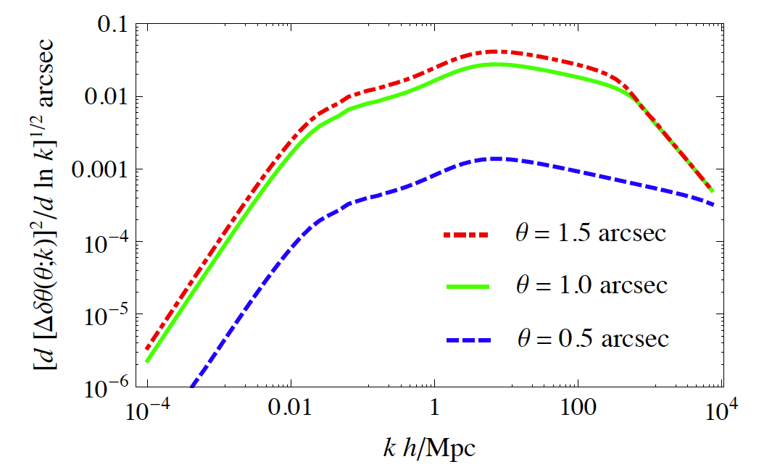
Astrometric perturbation
shear,convergence
SIS or SIE (+m3,m4)
LOSS
super
cluster
cluster
galaxy
satellite
mini-halo
KTI&Takahashi 2012
(z_{source}= 3 z_{lens}= 0.5)

Slide 25
LOS lensing estimate
Singular isothermal ellipsoid(SIE)
+external shear for the primary lens.
Astrometric shifts constraints (<0.003”)
for a half mean separation of images.
Power spectrum from N-body simulation.
(1024^3 & box size=10 Mpc/h DM only)
Secondary lenses (SIS/SIE) included in
the background lens model

Slide 26
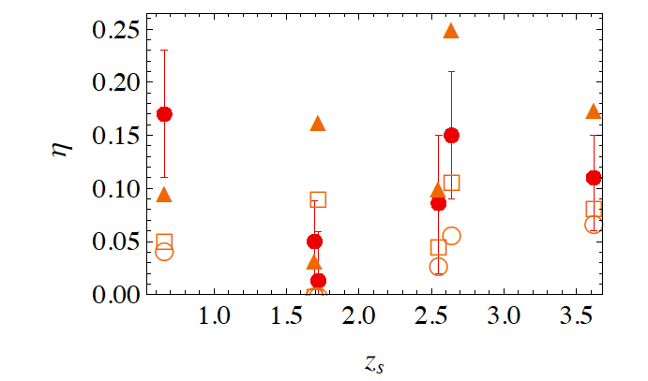
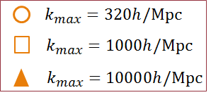
Magnification perturbation
LOS structures can sufficiently perturb fluxes !
KTI&Takahashi 2012

Slide 27
Subhalo lensing estimate
Semi-analytic mass function (Han et al. 2015)(z=0)(based on Aquarius&Phoenix)
projected on a lens plane
Redshift dependency is taken into account using the concentration parameter

Slide 28
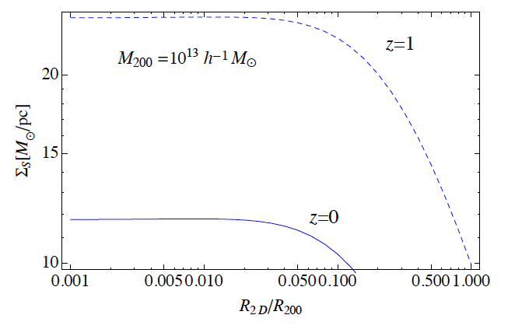
Surface mass density of subhalos
Distance from host halo center

Slide 29
Cause of constant SM density
・Host halo〜SIS Σ prop to 1/R
・Bound fraction prop to R (if subhalo
is SIS)
Subhalo SM density prop to 1/R×R=1
(at < Einstein radius of host halo)

Slide 30
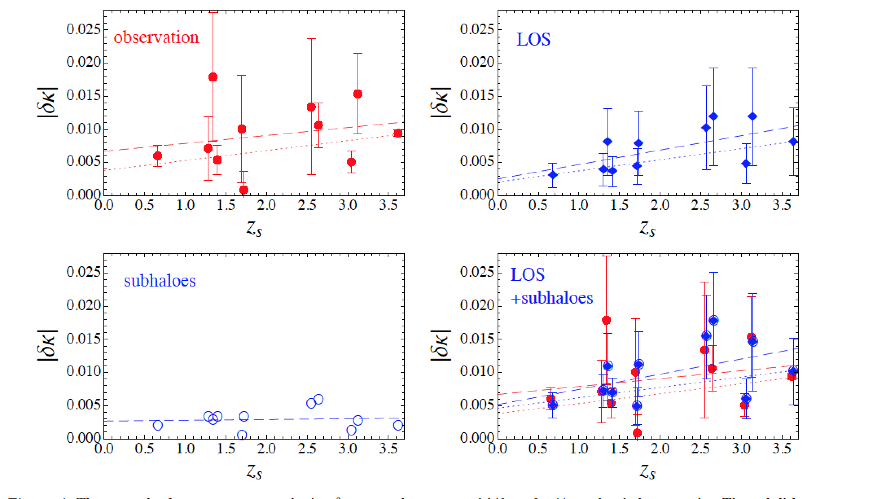
Convergences of 10 lenses

Slide 31
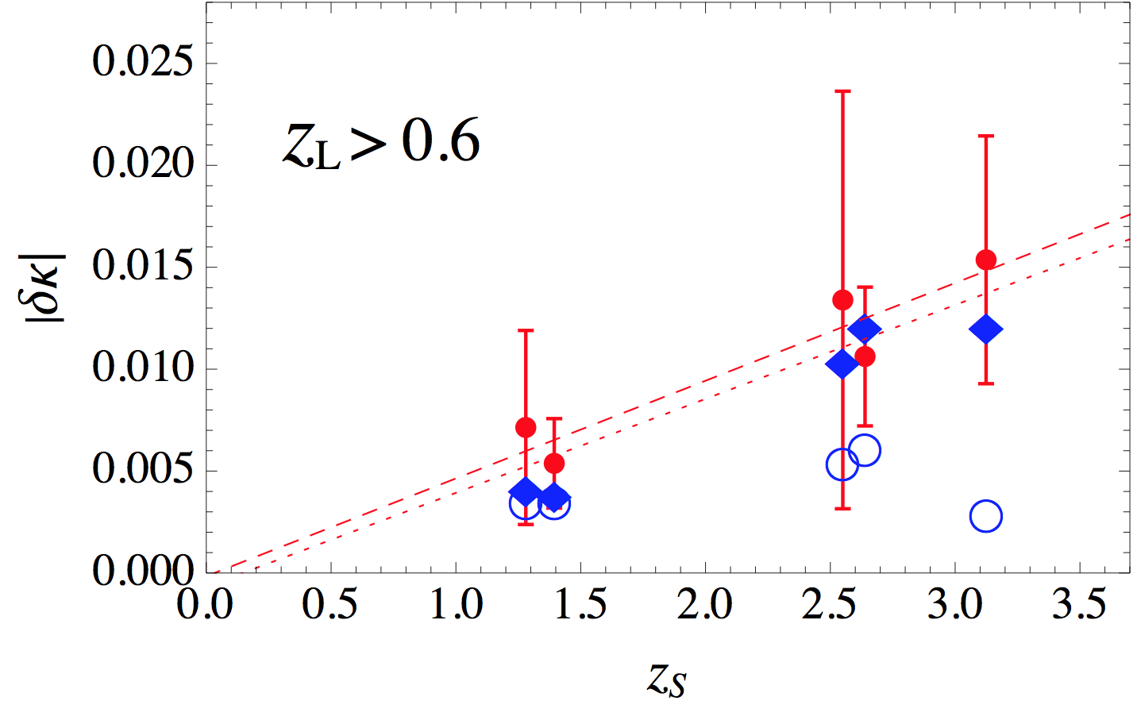
Convergence VS source redshift

Slide 32
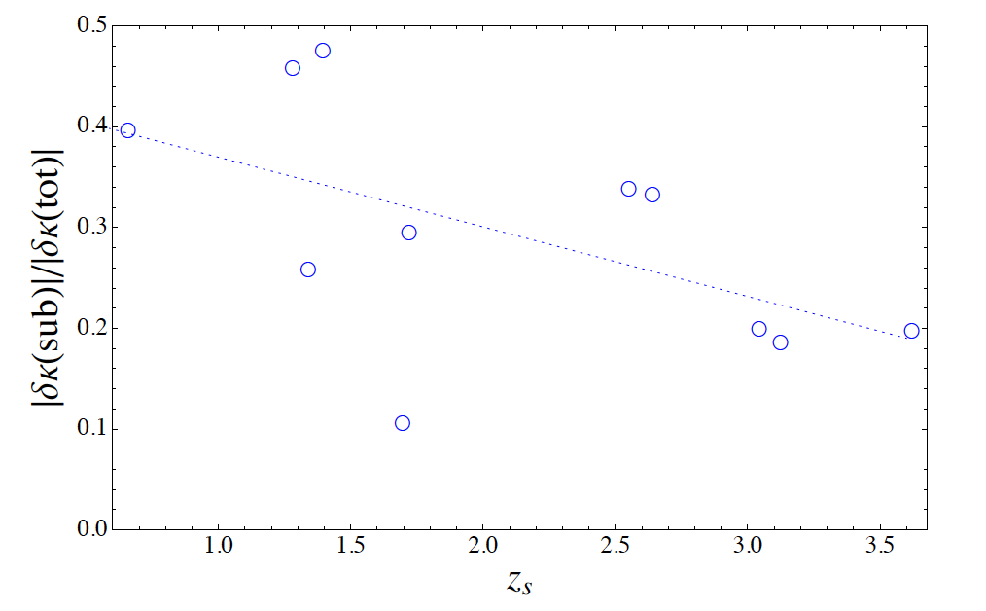
Subhalo lensing contribution
Subhalos are subdominant!

Slide 33




Imprint of small-scale structures of dark matter in the lensed submillimeter galaxy SDP.81
Kaiki Taro Inoue（KINDAI），Takeo Minezaki （Tokyo U.），
Satoki Matsushita（Academic Sinica），Masashi Chiba（Tohoku U.）
KAKENHI:JSPS Grant-in-Aid for Scientic Re-
search (B) (No. 25287062)
Japan Astronomical Society
Meeting@Konan U. 9 Sep. 2015

Slide 34
Ｗｈａｔ’ｓ New
First detection of flux ratio anomaly and astrometric anomaly in lensed SMG.
Developed a new analysis method for estimating lens perturbation in source plane.
Negative density perturbation.
Line-of-sight structures?

Slide 35
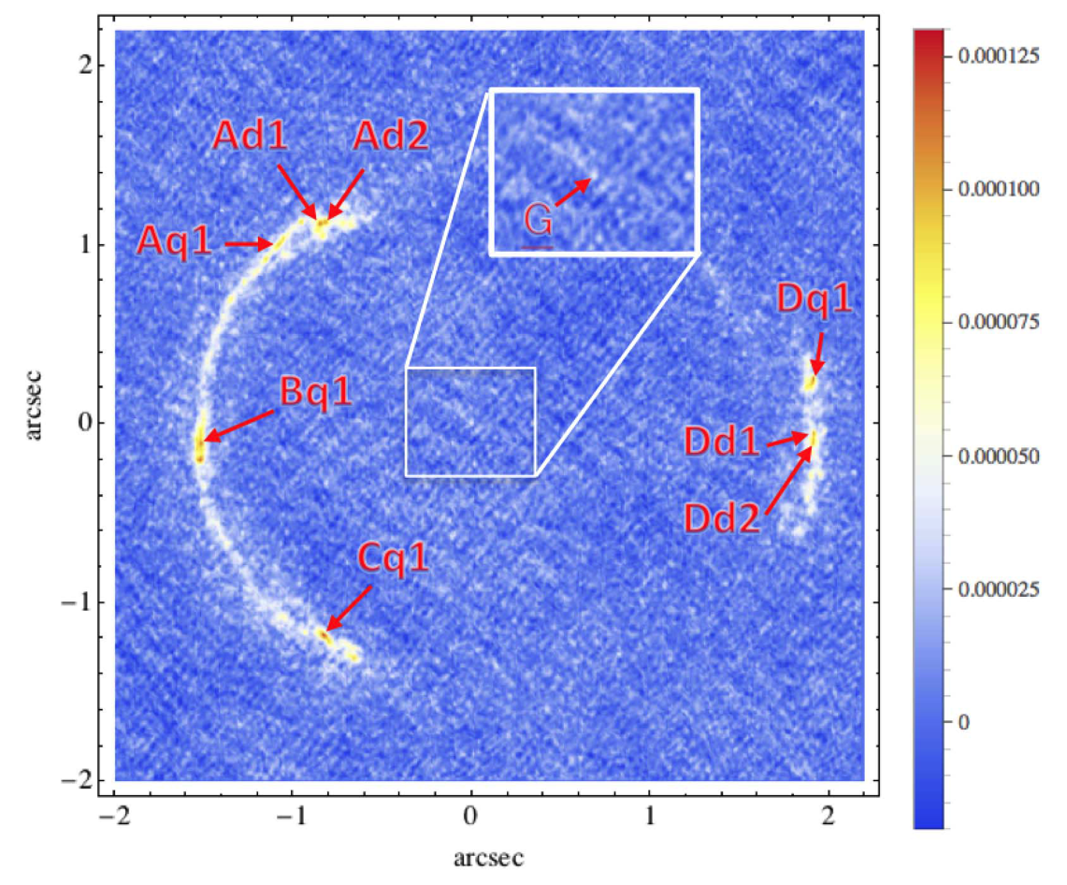
SDP.81(continuum〜1mm)
(ALMA band 7 science verification data )

Slide 36
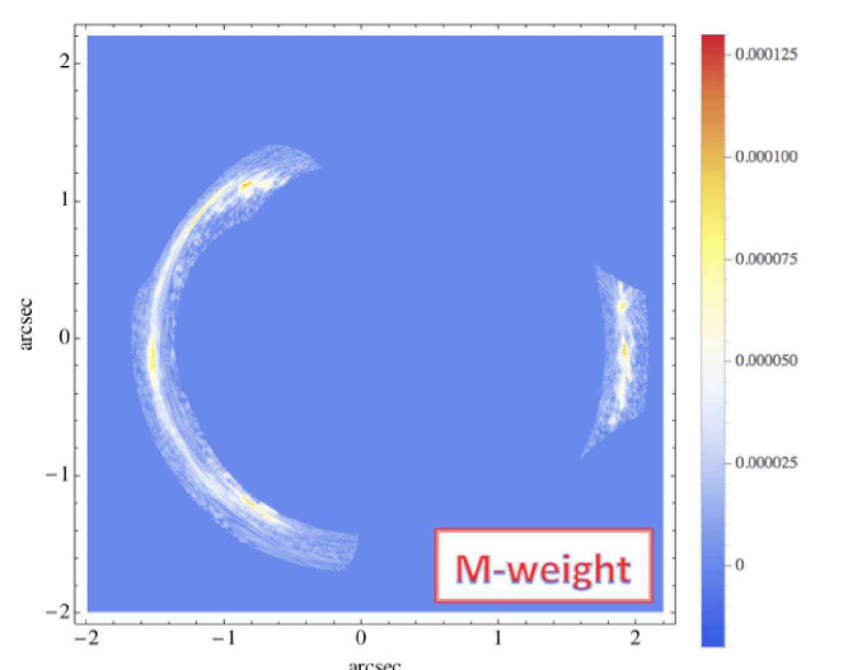
Modeled image

Slide 37
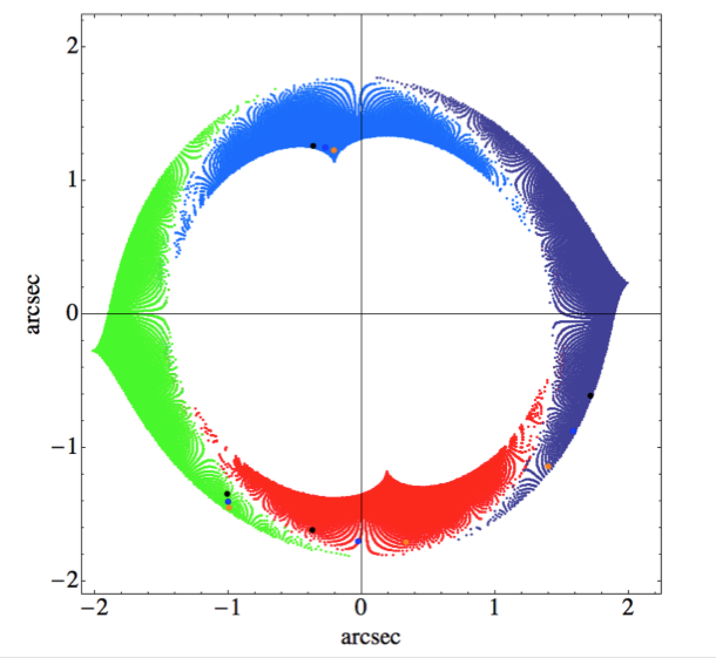
Four lensed image regions
A
(-,+)
D
(+,+)
B
(+,+)
C
(-,+)

Slide 38
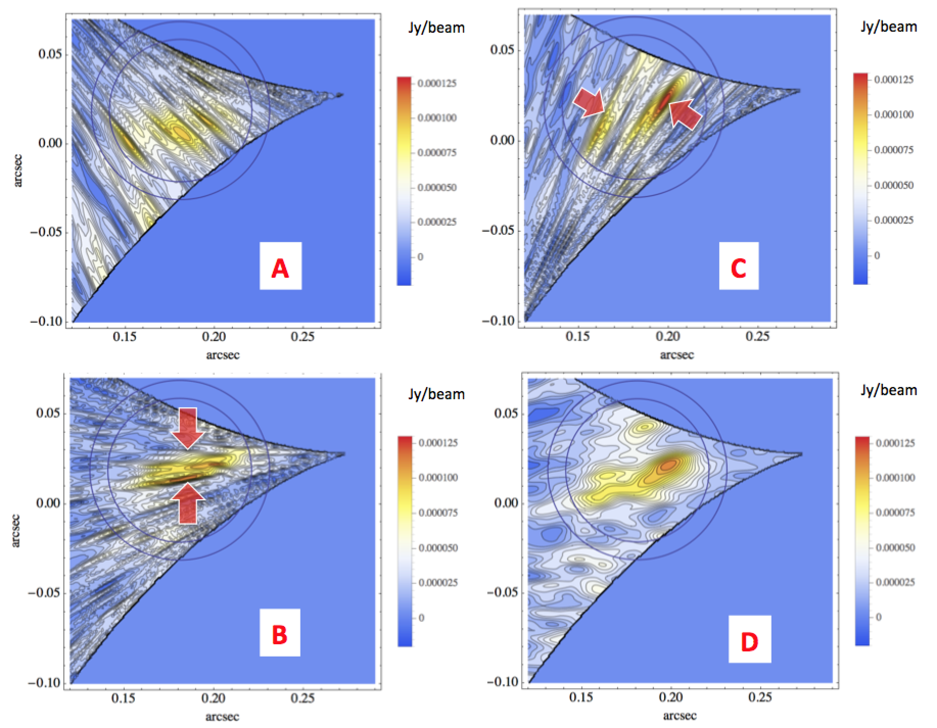
Inverted images
~ 3 σ anomaly
in aperture
fluxes (B & C)
20 % decrease
20 % decrease

Slide 39
Parity & magnification change
always magnified
(+ +) parity
demagnified or magnified
(+ −) parity

Slide 40
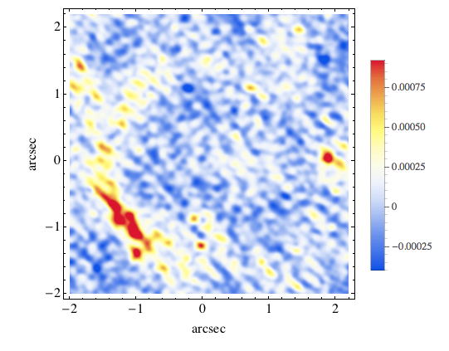
SDP.81 (CO(8-7) )
(ALMA band 6 science verification data)

Slide 41
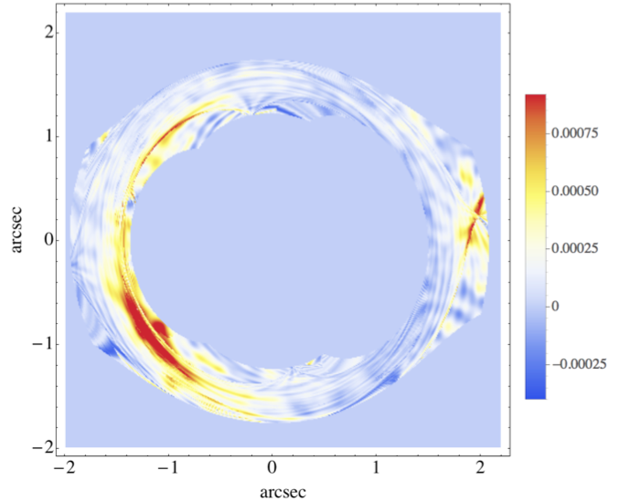
Modeled image

Slide 42
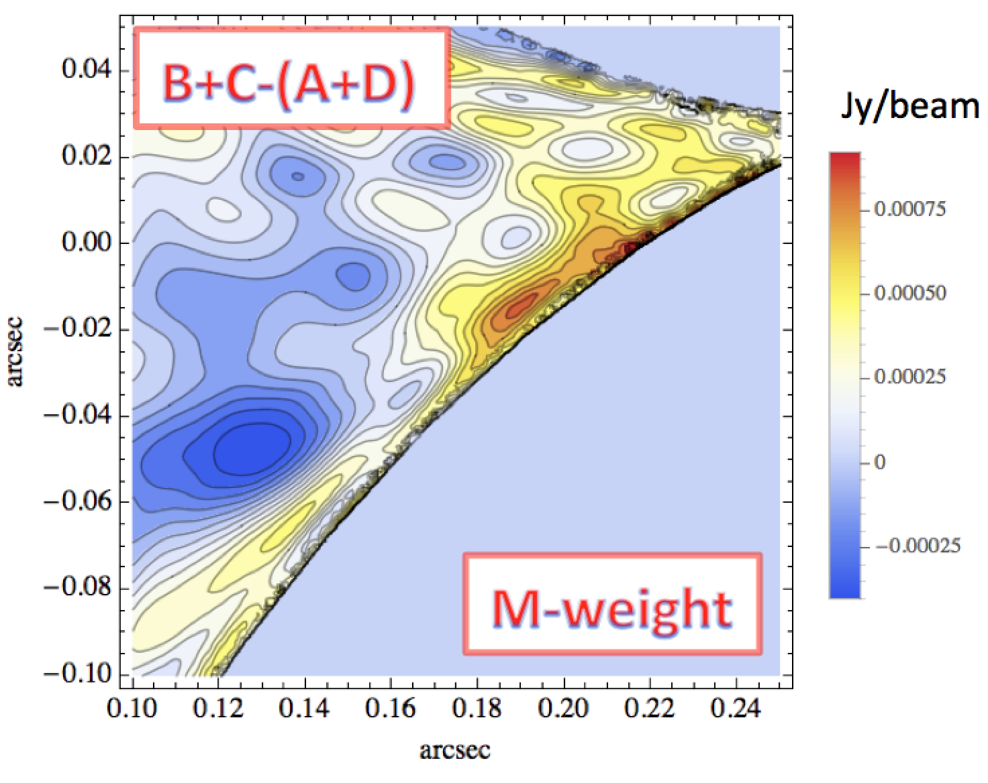
~ 3 σ anomaly
in astrometric
shifts

Slide 43
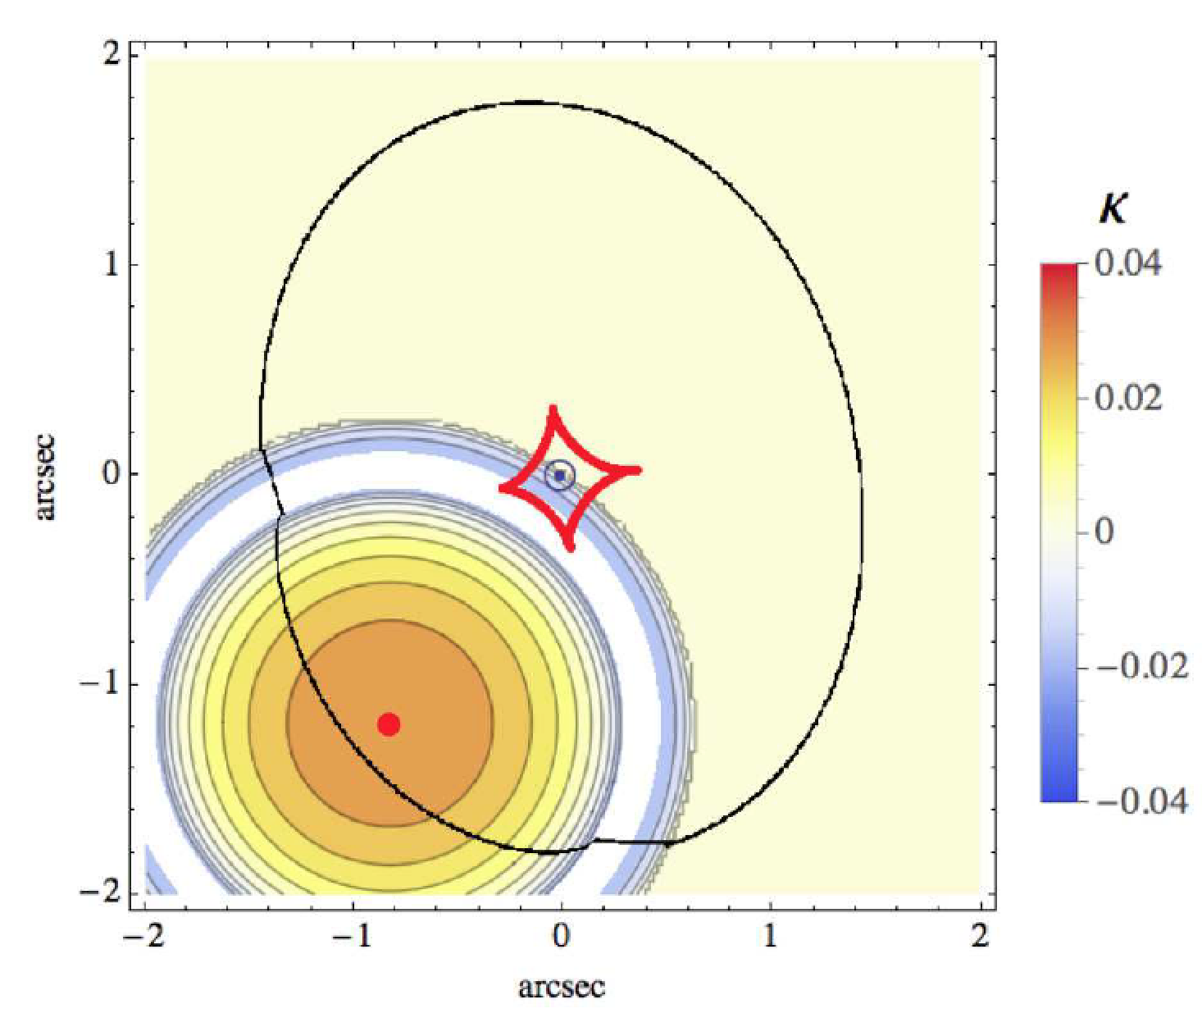

Slide 44
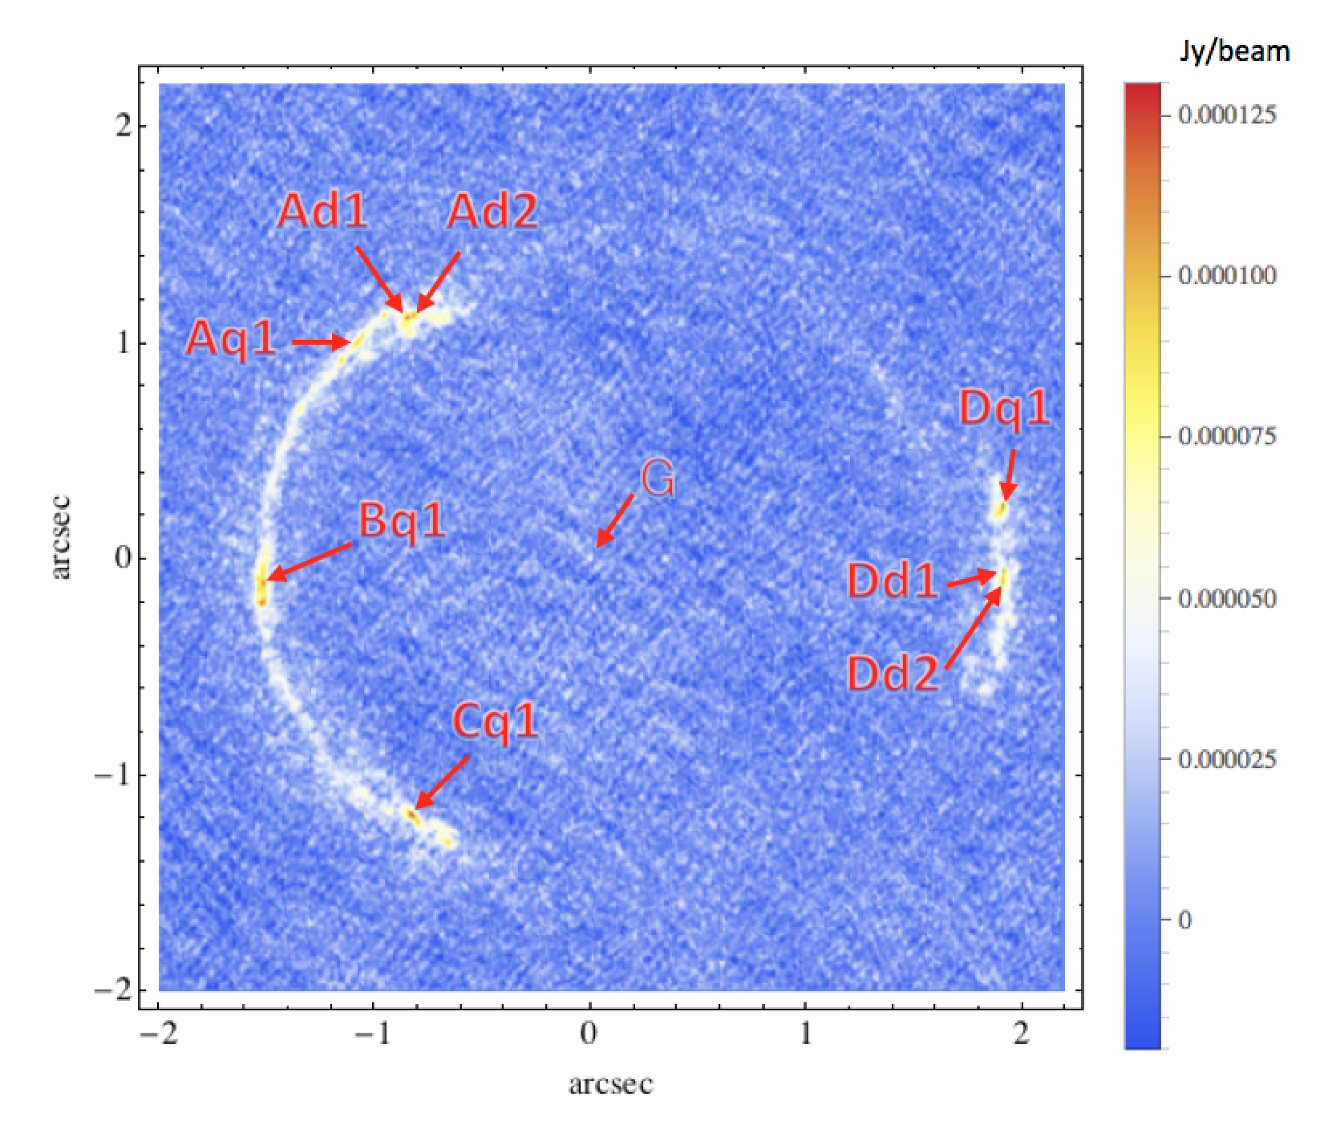
From B to C
a dwarf-sized
halo may reside!

Slide 45
3 months after
submission to
arXiv Oct.
2015…

Slide 46
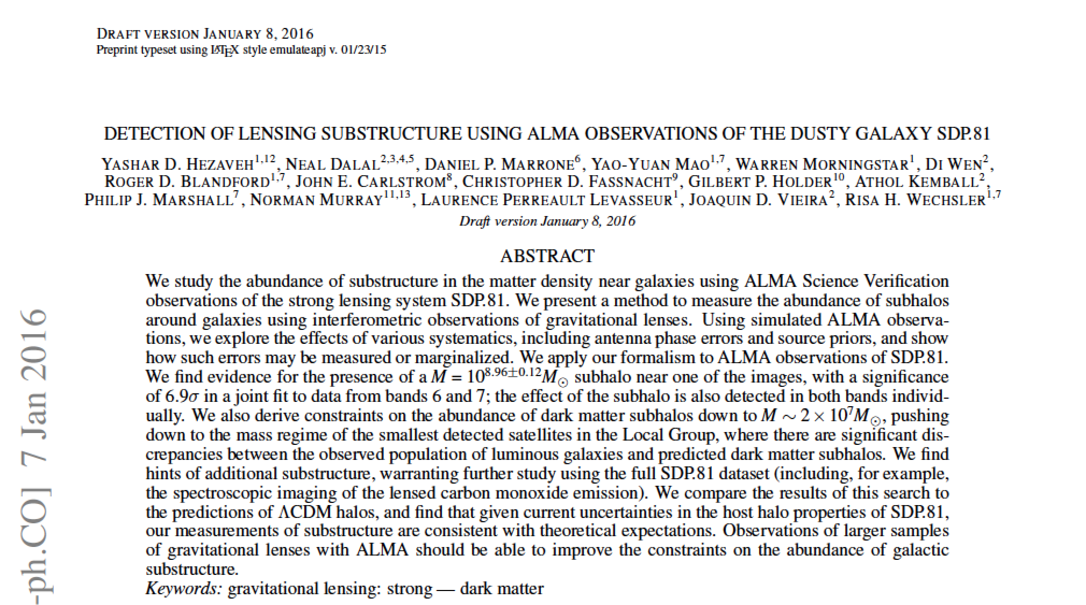

Slide 47
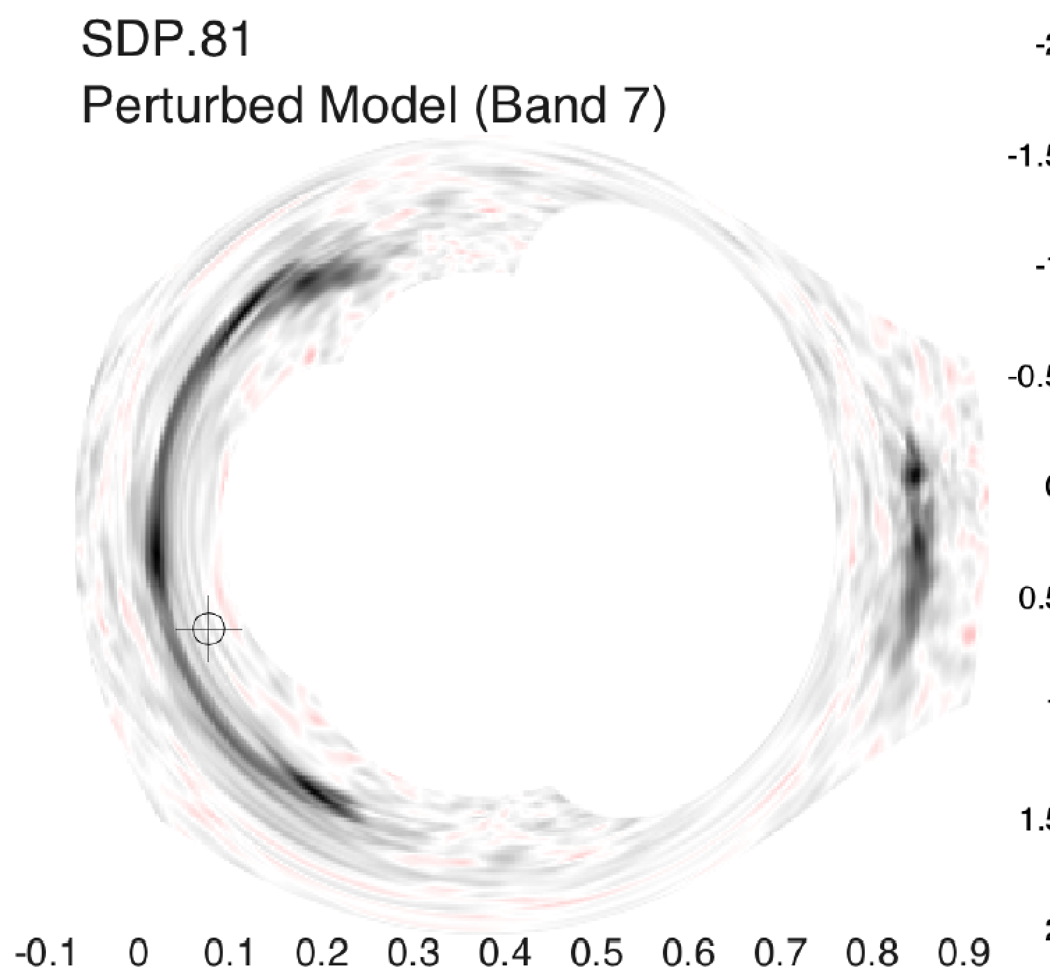
Hezaveh et al. 2015

Slide 49
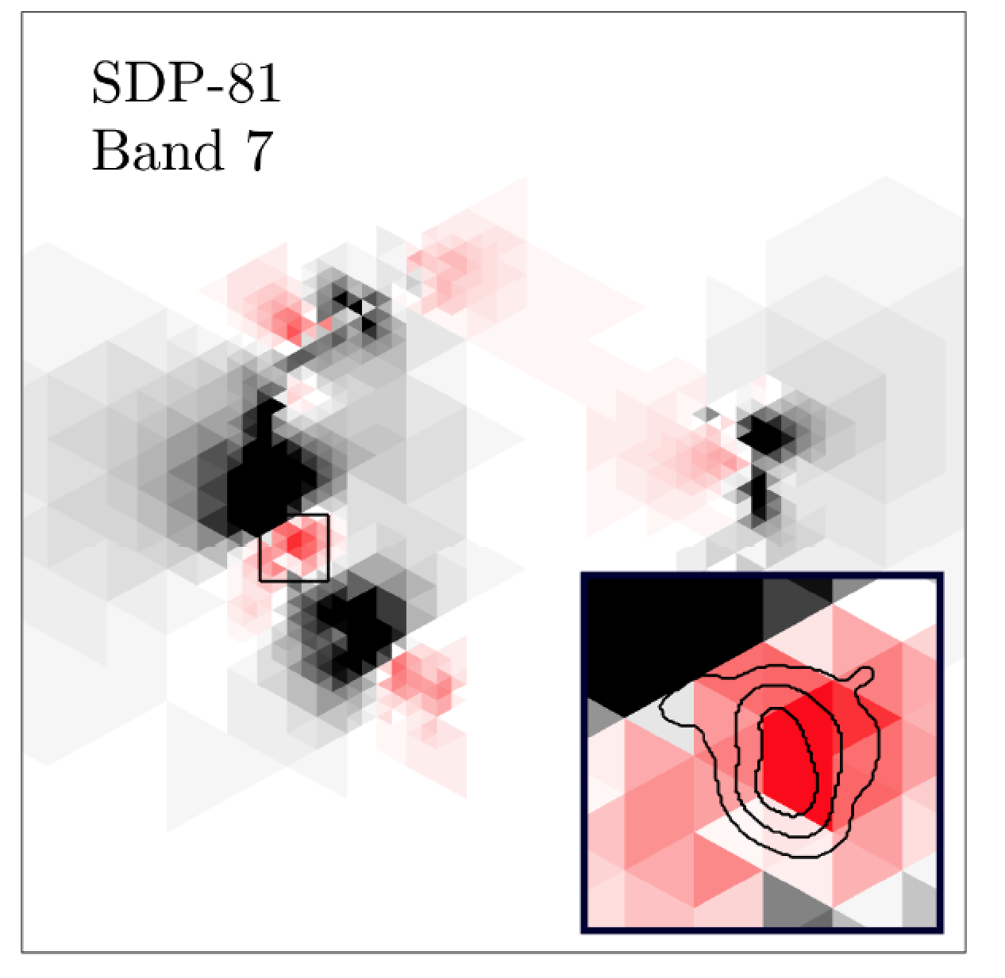

Slide 50
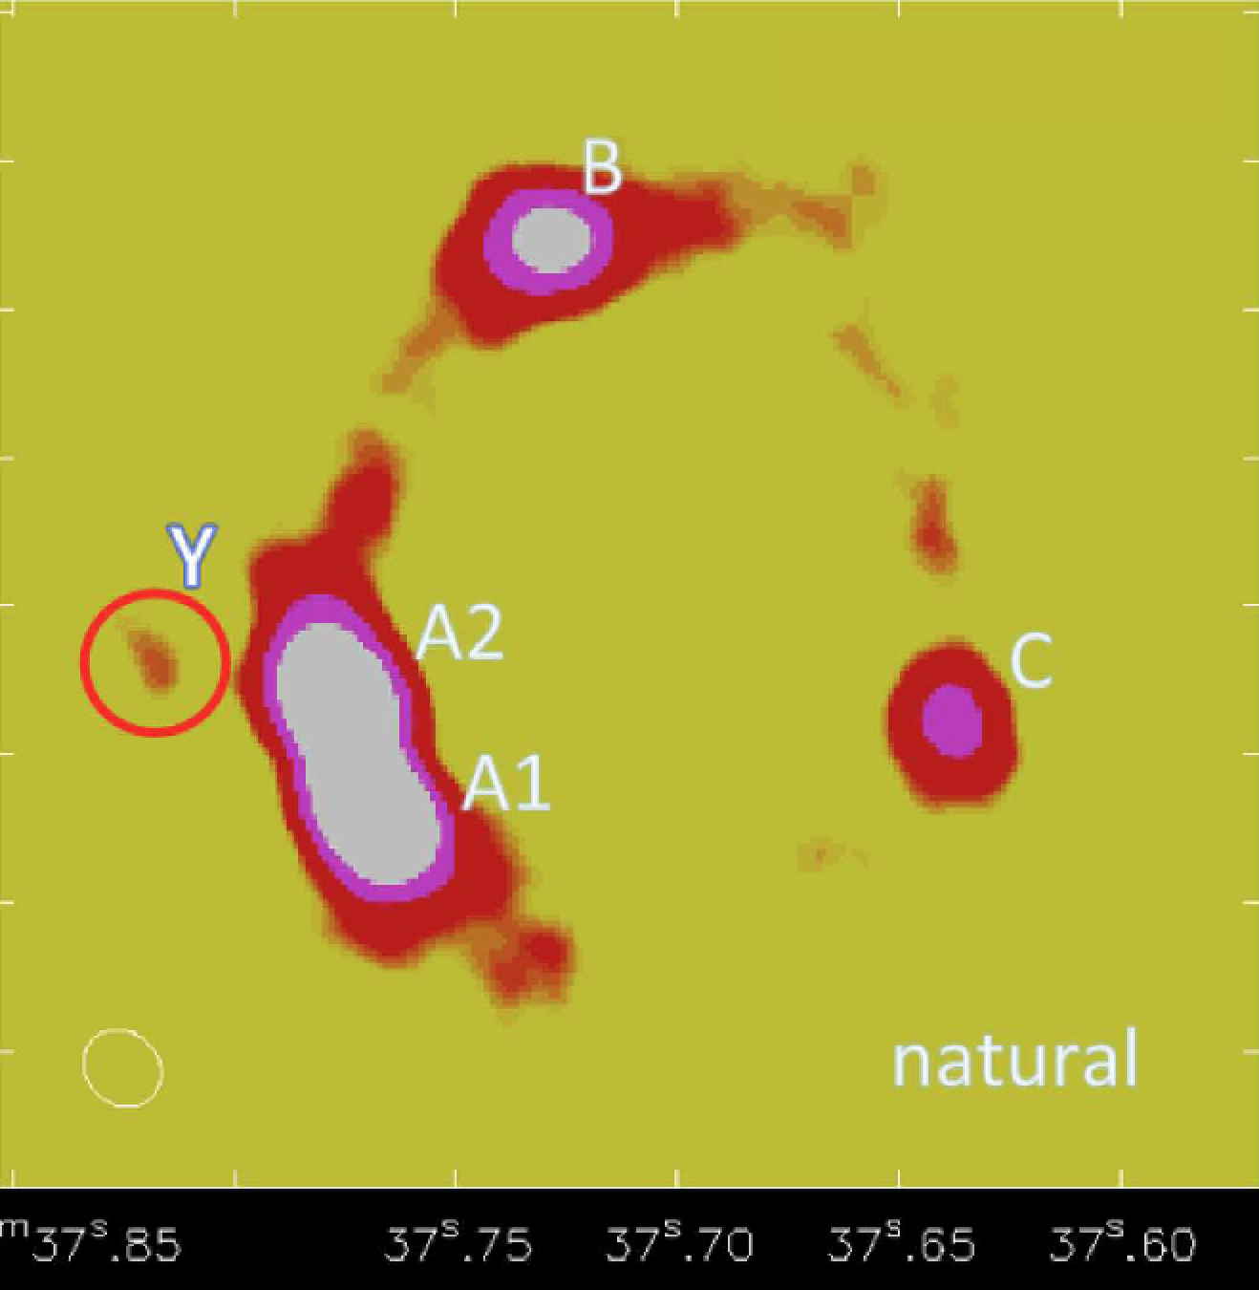
Dark Dwarf Galaxy Spotted
Released
to press
(from KINDAI
& U-Tokyo, Feb. 9)
Asashi(Feb.10)
Yomiuri (Feb.19)
June 13 &
August 14 ’15
~340 GHz
Integration time: 157 min.
PI: KTI
(ALMA band 7 dust continuum image )

Slide 51
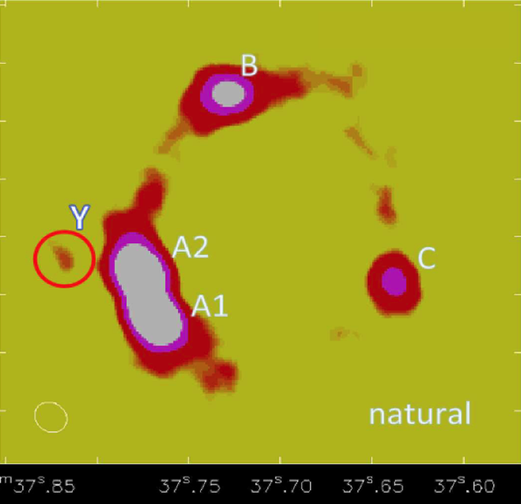
MG0414+0534 (NIR)

Slide 52
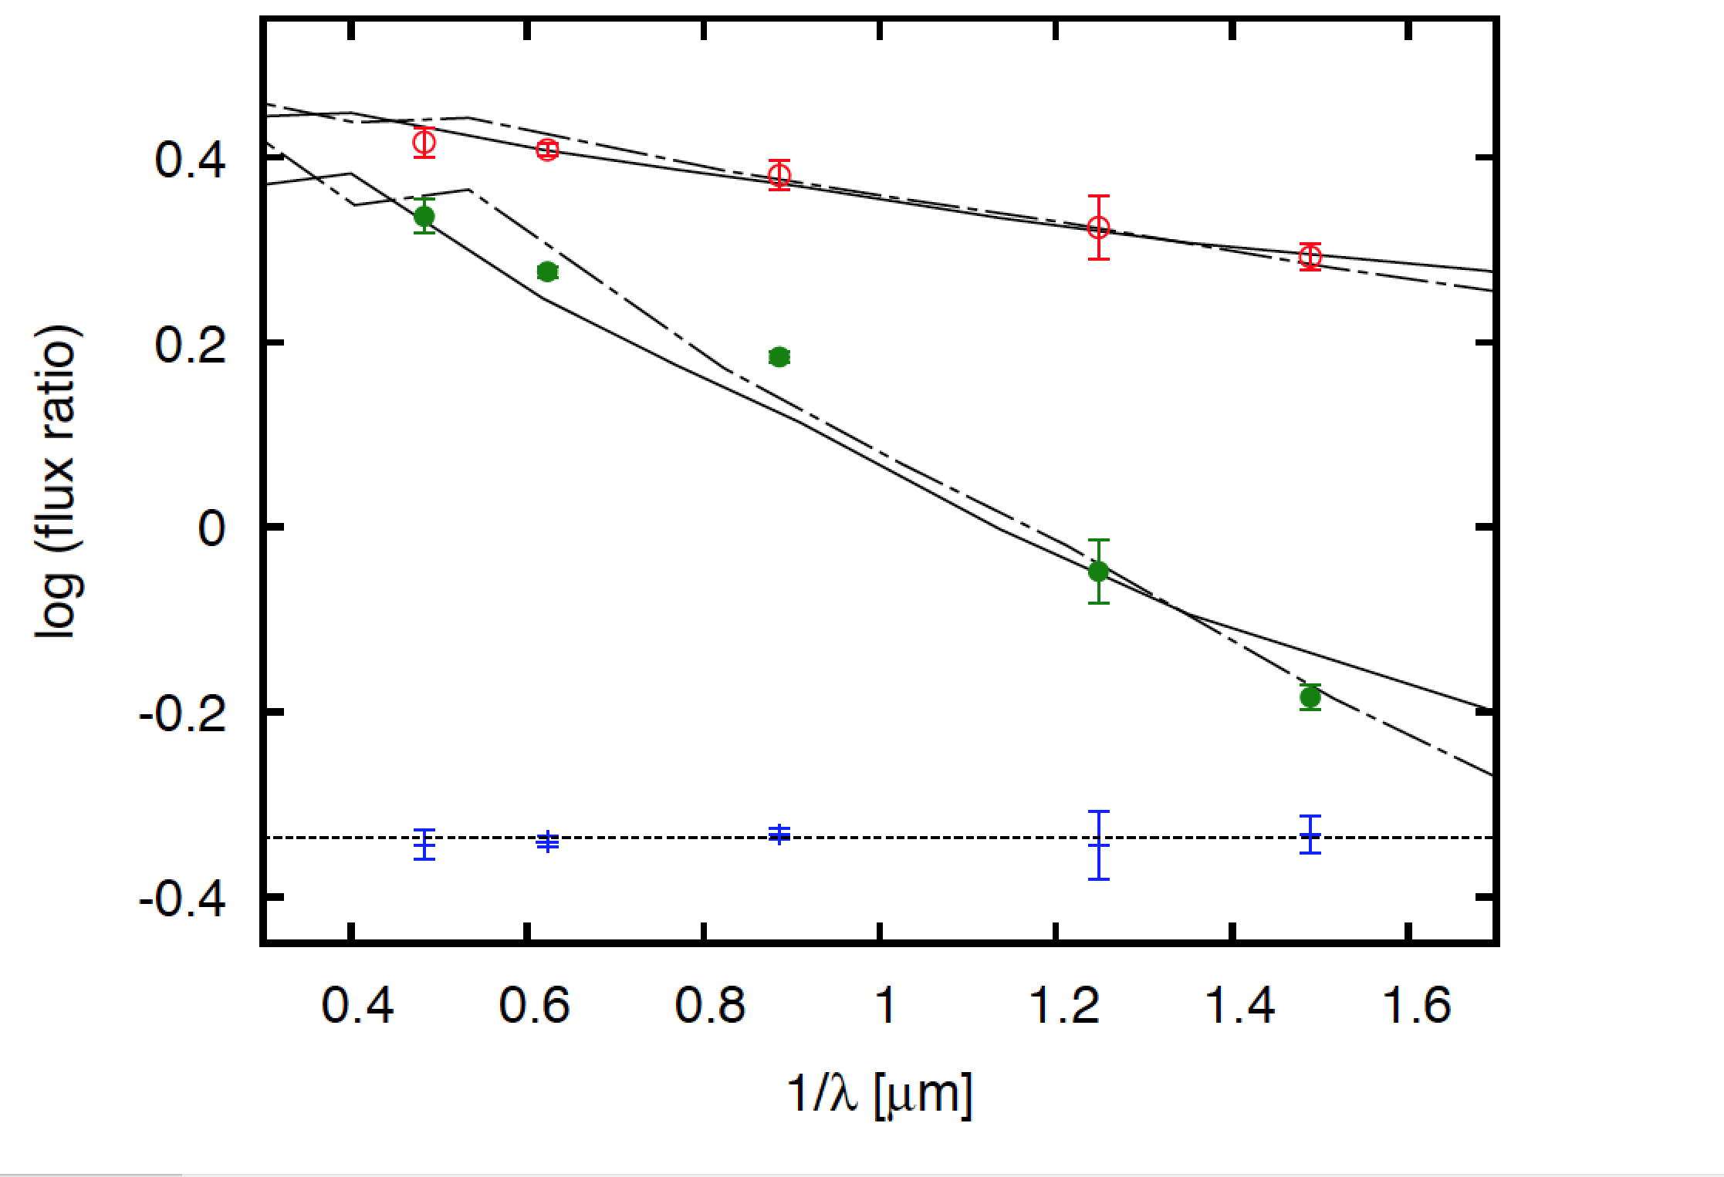
A1/B
A2/B
C/B

Slide 53
Dusty dark dwarf galaxy?
Faint object ‘Y’ detected (~0.3 mJy, at >4σ)
Dust mass is 10^6~10^7 Ms
Explain 10% decrease in A1 if Y has a mass of 10^9 Ms
Explain dust extinction in opt/NIR fluxes if dust traces DM (SMC DE curve) −＞ dust mass 10^7 Ms

Slide 54
What’s New
The detected submm flux is most probably coming from a dark dwarf galaxy at a cosmological distance.
Explain anomalous flux ratios & dust extinction if Y is a dusty dark dwarf.

Slide 55
Possible origin
Ultra diffuse galaxy (UDG) or its progenitor at cosmological distance ?
Either associated with an LOS halo at 0.5<z<1 or a subhalo at z=0.958
HI absorption at z_lens=0.958 prefers the subhalo scenario.

Slide 56
Summary
Graviational lensing can be used for detecting dark dwarf galaxies at cosmological distances.
LOS halos (voids) dominate over subhalos in ‘substructure lensing’.
The detected dusty dark dwarf galaxy may be common in the universe.

